Slide 1
CS487-Introduction to competitive programming: A2SV
Lecture #10: Binary Search, Heaps

Slide 2
Search
Problem: Given a sorted array of n elements, search a given element e in the array
Naive solution: Compare each element of array with x one by one a.k.a linear search
O(N)

Slide 3
Binary Search
Start from the middle element;
If x is equal, return true
If x is greater, go to the right half
Go to the left half otherwise
Continue until you have one element
We are repeatedly dividing the array by half at each step; therefore O(logN)

Slide 4
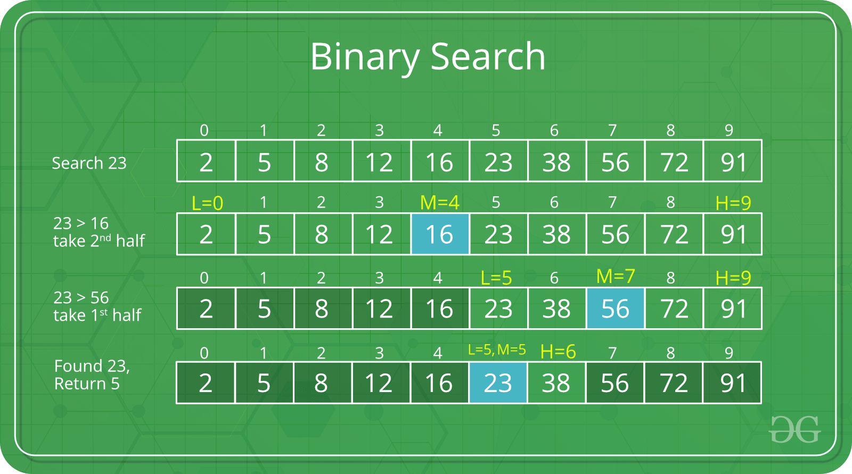
Binary Search Example

Slide 5
Recursive Binary Search In C++
int binarySearch(int nums[], int l, int r, int x)
{
if (r >= l) {
int mid = (l + r) / 2;
if (nums[mid] == x) {
return mid;
}
if (nums[mid] > x) {
return binarySearch(nums, l, mid - 1, x);
}
return binarySearch(nums, mid + 1, r, x);
}
return -1;
}

Slide 6
Iterative Binary Search in C++
int binarySearch(int nums[], int l, int r, int x)
{
while (l <= r) {
int mid = (l + r) / 2;
if (nums[mid] == x) {
return mid;
}
if (nums[mid] < x) {
l = mid + 1;
}
else {
r = mid - 1; }
}
return -1;
}

Slide 7
Programming exercises
Peak in a mountain array
Find positive integer solution for a given equation
First bad version
Binary search
H-index II
Find the smallest divisor given a threshold
Online election
Binary Search

Slide 8
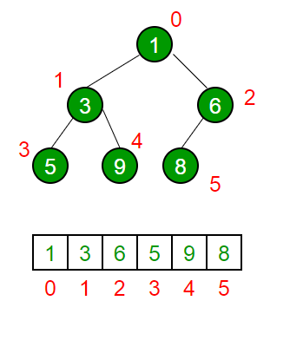
Binary Heap
A binary min-heap
Is a complete tree
Each node is smaller than or equal to its children
A binary max-heap
Is a complete tree
Each node is larger than or equal to its children
Can be stored in an array since it’s complete binary tree

Slide 9
Heap Applications
Heapsort (how?)
Priority Queue
Emergency room
Some graph algorithms
Shortest path
Minimum spanning tree

Slide 10
Heap Operations
Insert -> O(logN)
Remove -> O(logN)
Modify -> O(logN)
GetMin -> O(1)
Heapify -> O(N)

Slide 11
Programming exercises
Kth largest element in a stream
Top K frequent elements
Top K Frequent Words
Merge K Sorted Lists
Heap

Slide 12
Quote of the day
"The greatest mistake you can make in life is to be continually fearing you will make one." —Elbert Hubbard

